Slide 1

The Spring Framework
A quick overview

Slide 2
The Spring Framework
What is Spring framework & its advantages
Spring principles: IoC
Spring principles: AOP
A handful of services
A MVC framework
Important Spring Annotations
Q & A

Slide 3
1. What is Spring framework & its advantages
The Spring Framework is a Java platform that provides comprehensive infrastructure support for developing Java applications. Spring handles the infrastructure so you can focus on your application.
Spring enables you to build applications from "plain old Java objects" (POJOs) and to apply enterprise services non-invasively to POJOs. This capability applies to the Java SE programming model and to full and partial Java EE.
Examples of how you, as an application developer, can benefit from the Spring platform:
Make a Java method execute in a database transaction without having to deal with transaction APIs.
Make a local Java method a remote procedure without having to deal with remote APIs.
Make a local Java method a management operation without having to deal with JMX APIs.
Make a local Java method a message handler without having to deal with JMS APIs.

Slide 4
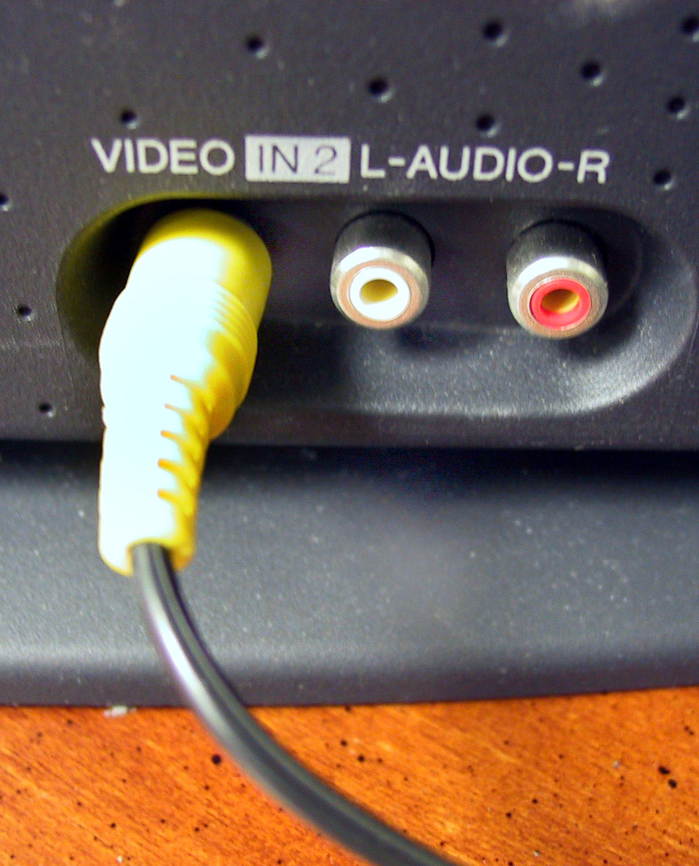
2. Spring principles: IoC
Inversion of Control: an object interacts with its environment
Objects are « plugged » one in another
The environment is set up by the container instead of the object itself

Slide 5
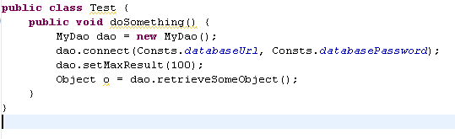
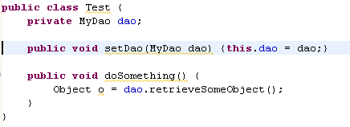
2. Spring principles: IoC
Without IoC:
With IoC

Slide 6
2. Spring principles: IoC
Useful for separating dao and business layer
Useful for separating controllers and business layer
The code is more extensible, easier to read, and modules/layers can easily be replaced

Slide 7
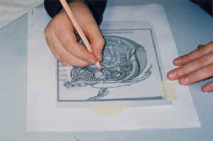
3. Spring principles: AOP
Separates the core business code from the aspects we wrap around it: security, transaction management, …
Through AOP, we add transversal functionalities to objects (ie not directly related to the code it contains)

Slide 8
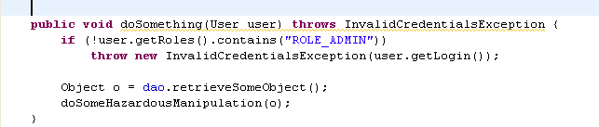
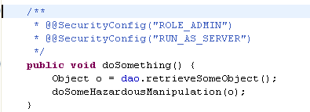
3. Spring principles: AOP
Without AOP
With AOP

Slide 9
3. Spring principles: AOP
Useful for automatic handling of transaction with Hibernate
Useful for Acegi (automatic credentials checking before executing some methods)
Code smaller, easier to read (not polluted by transversal aspects not directly relevant)

Slide 10
4. A handful of services

Slide 11
4. A handful of services
DAO support: Spring offers templates classes to deal with a Hibernate/JDBC/… connection
Exception translator: all the proprietary Hibernate/JDBC/… exceptions are catched by Spring, and rethrown as Runtime non-specific consistent exceptions
Hence the DAO code is not dependant on the underlying datasource!

Slide 12
4. A handful of services
Many ORM tools are supported: Hibernate, JDO, Apache OJB, iBATIS
Templates using IoC to reduce the amount of code in the DAO objects

Slide 13
4. A handful of services
Support of RMI
Very easy to expose and connect to webservices
Support of JMS
JMS templates, JMSException translation

Slide 14
4. A handful of services

Slide 15


4. A handful of services
A mail abstraction layer
Templates
Jobs scheduling (Quartz, Timer)
Cron
Business layer unaware

Slide 16
5. A full MVC Framework
Clear separation of roles: controller, validator, form object, Dispatch servlet, View resolver, …
Extensible and adaptable
Several views of a result (pdf, excel, html, …)
Can be wired (possible to use transparently the IoC pattern)

Slide 17
5. A full MVC Framework
Can be used with other frameworks: JSF, Struts, Tapestry, Webwork
Completely transparent: no need to change anything in what is done by these other frameworks

Slide 18
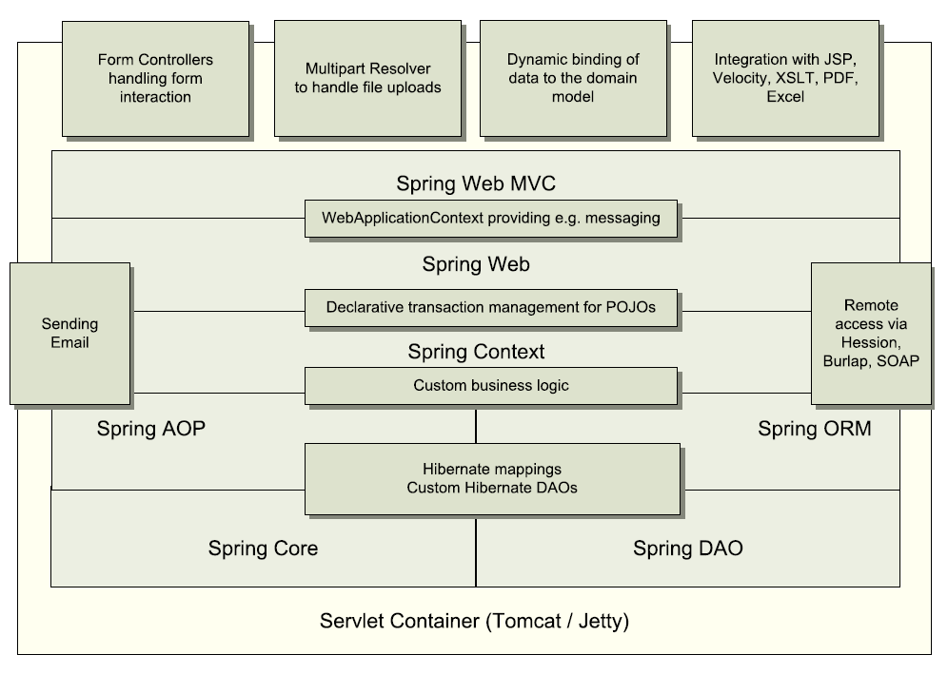
5. A full MVC Framework

Slide 19
6. Important Spring Annotations
The Four Types of Spring Stereotype Components and Their Purposes:
+------------+-----------------------------------------------------+
| Annotation | Meaning |
+------------+-----------------------------------------------------+
| @Component | generic stereotype for any Spring-managed component |
| @Repository| stereotype for persistence layer |
| @Service | stereotype for service layer |
| @Controller| stereotype for presentation layer (spring-mvc) |
+------------+-----------------------------------------------------

Slide 20
Q & A
Thank You
Shobhanath Sharma

